Slide 1

스마트 기저귀 (Smart Diaper)
Project
Hanggies
Process
Q&A
Background
Expectation
Function
Expectation View
Structure
Environment
Schedule
팀명 : Hanggies
지도교수 : 황호영 교수님
1192074 임영찬
1392078 조민수
1392079 최낙훈

Slide 2
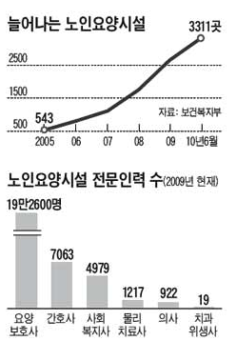
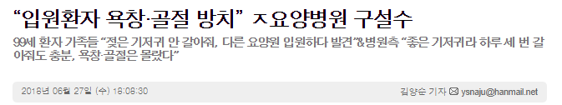
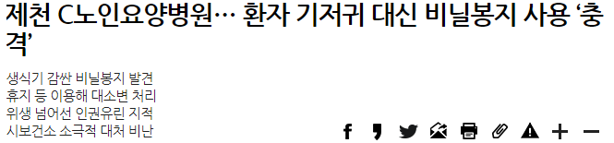
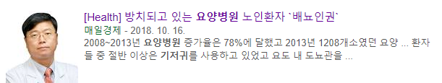
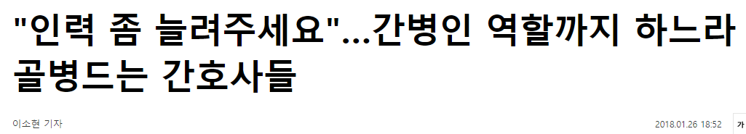

Project
Hanggies
Process
Q&A
Background
Expectation
Function
Expectation View
Structure
Environment
Schedule

Slide 3
Project
Hanggies
Process
Q&A
Background
Expectation
Function
Expectation View
Structure
Environment
Schedule
환자의 존엄성
업무의 효율성
서비스의 신뢰성

Slide 4
Project
Hanggies
Process
Q&A
Background
Expectation
Function
Expectation View
Structure
Environment
Schedule
대·소변 감지
기저귀 교체 알림
기저귀 상태 및 이력 조회

Slide 5


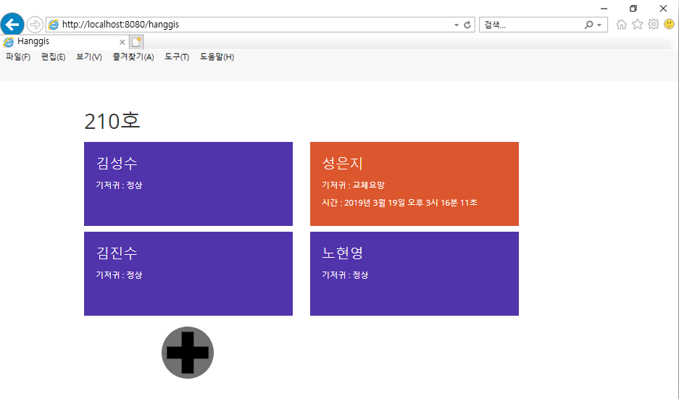
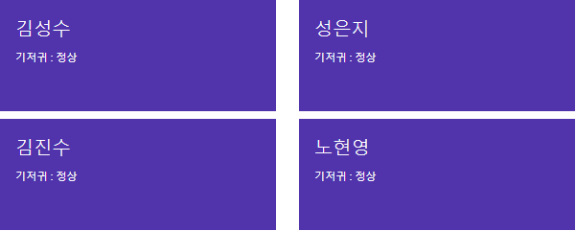
Project
Hanggies
Process
Q&A
Background
Expectation
Function
Expectation View
Structure
Environment
Schedule
[Push]
210호 성은지환자 기저귀 교체요망
감지!!

Slide 6






Project
Hanggies
Process
Q&A
Background
Expectation
Function
Expectation View
Structure
Environment
Schedule

Slide 7



Project
Hanggies
Process
Q&A
Background
Expectation
Function
Expectation View
Structure
Environment
Schedule

Slide 8

















Project
Hanggies
Process
Q&A
Background
Expectation
Function
Expectation View
Structure
Environment
Schedule
타겟 머신
개발 도구
개발 언어

Slide 9
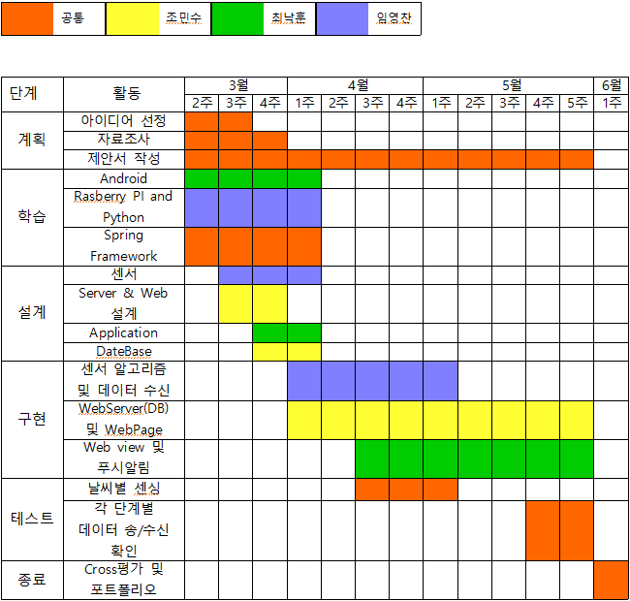
Project
Hanggies
Process
Q&A
Background
Expectation
Function
Expectation View
Structure
Environment
Schedule

Slide 10

Project
Hanggies
Process
Q&A
Background
Expectation
Function
Expectation View
Structure
Environment
Schedule

